Slide 1
Progressive Web App for Crestron System
DIT | 160902S Aung Thura Zaw | 152786T Muhammed Rizwanullah

Slide 2
Contents
Problem Definition
Target Audience
Technologies Used
Project Features
Project Schedule and Task Allocation
Task Completed for Interim Stage
Task Completed for Final Stage
Overview of App Usage
9. Demo

Slide 3
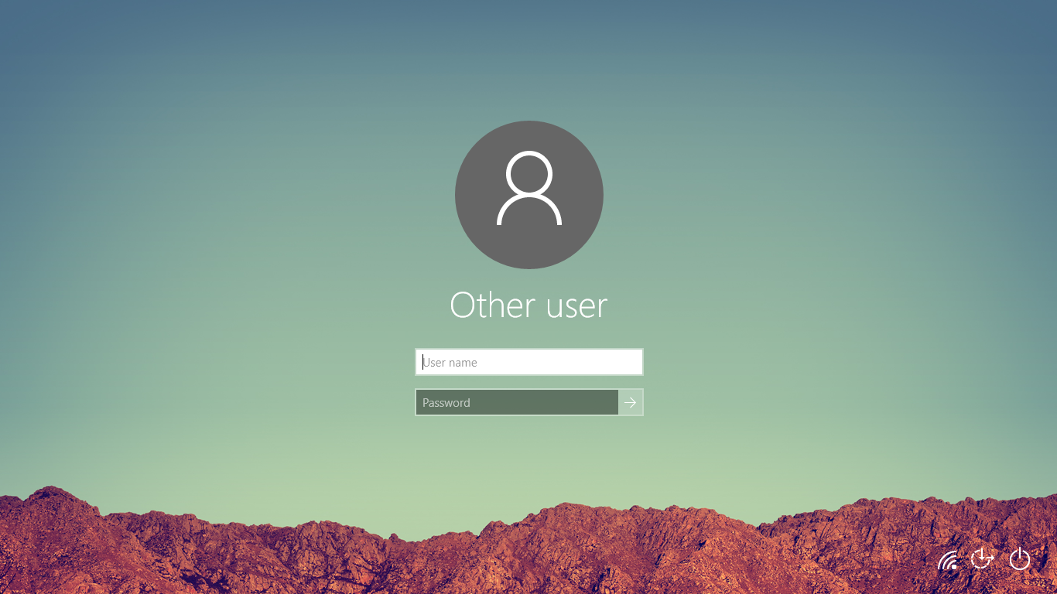
Problem Definition
Login PC to access system
Time-Consuming
Inconvenient

Slide 4

Target Audience
NYPSIT
Lecturers
Tutors
Students

Slide 5






Technologies Used
Ionic 3
Angular 4
HTML, CSS & JavaScript
Window Server 2016
XCode
C# ASP.Net MVC
Microsoft SQL Server 2014 Enterprise Edition

Slide 6
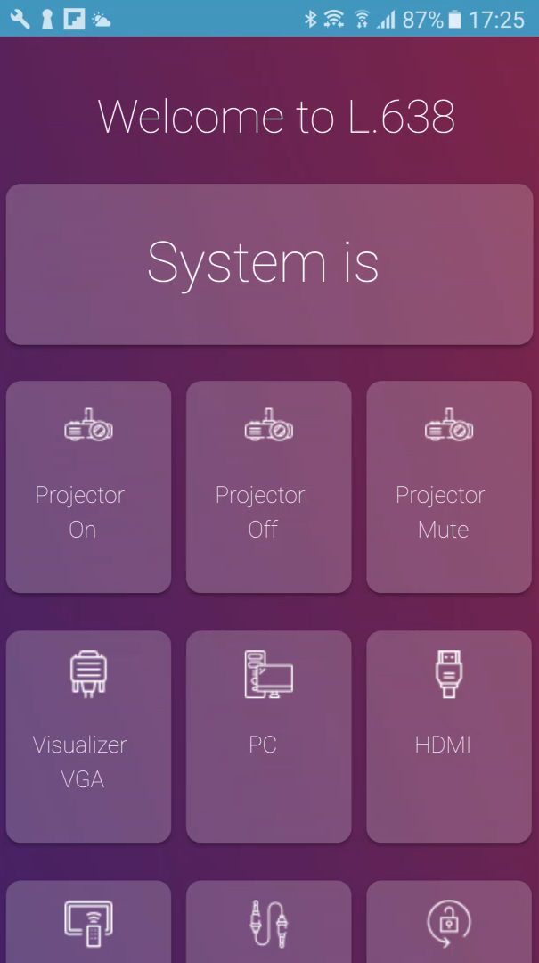
Project Features
NYP iProjection comprises of inbuilt features such as:
Projector On/Off Controls
Projector Screen Controls
Auto Lock
Volume Controls
Switch Projection Controls

Slide 7
Project Schedule and Task Allocation
Week 1
Week 2
Week 3
Week 4
Week 5
Week 6
Week 7
Understanding Ionic 3 & Angular 4
Understanding C# ASP.Net MVC
Connect Ionic application to the school’s active directory for authentication
Ensure mobile application is compatible on both iOS and android platforms
Integration of new mobile App design
Create NYP iProjection Manager web application to manage usage of the app
Setting up of the project done by the previous batch
Designing of NYP iProjection Manager web application
Ensure that event logs are captured during usage of mobile app
Integration of the iProjection Manager web application with the new design
Re-designing of the NYP iProjection mobile application
Both
Thura
Rizwan

Slide 8
Project Schedule and Task Allocation
Week 8
Week 9
Week 10
Week 11
Week 12
Convert Server from http to https
Development of a Progressive Web Application for the NYPiProjection mobile app
Passing of the codes over to Supervisor
Encryption of the room numbers
Ensure only 1 user is allowed to use the projector in 1 room at a time
Ensure that app can be downloaded/accessed from the web
Designing of the app download page
Both
Thura
Rizwan

Slide 9
Tasks Completed for Interim Stage
Creation of NYP iProjection manager web application
Capture event logs during usage of mobile application
Connect Ionic application to the school’s active directory for authentication
Ensure mobile application can be used on both IOS and Android platforms
Re-designing of the NYP iProjection mobile application
Designing of NYP iProjection Manager web application

Slide 10
Tasks completed for Final Stage
Only one user is allowed to use the projector in one room
Convert the hosting area of the NYP iProjection Manager Web Application from http to https
Development of a Progressive Web Application for the NYP iProjection mobile app
Encryption of the room numbers
Development of an app distribution page

Slide 11



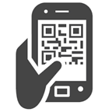


Overview of App Usage
SIT Domain
NYP iProjection Manager
Authentication Successful
Capture projector event & the user using the room
NYP iProjection
Login
Controls: Projector, Screen and Mic volume
Scan QR Code

Slide 12
DEMO

Slide 13
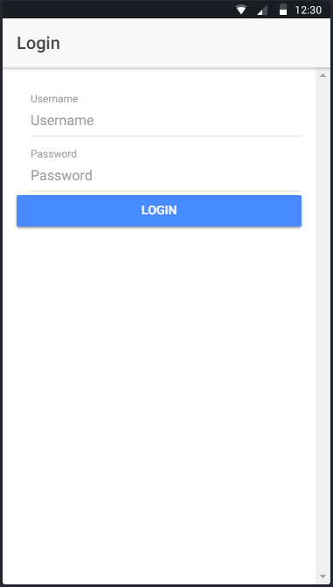
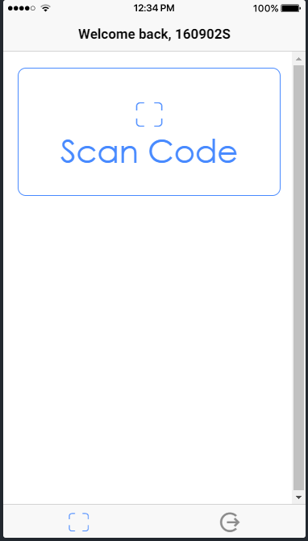
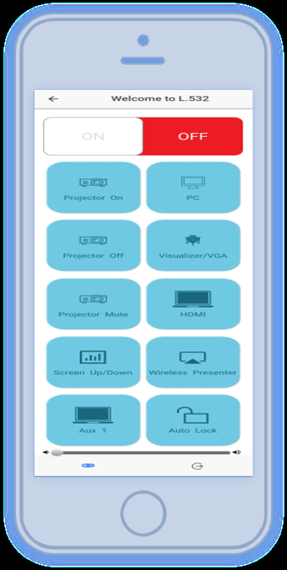
Previous Design
Login Page
Scan Page
Control Page

Slide 14
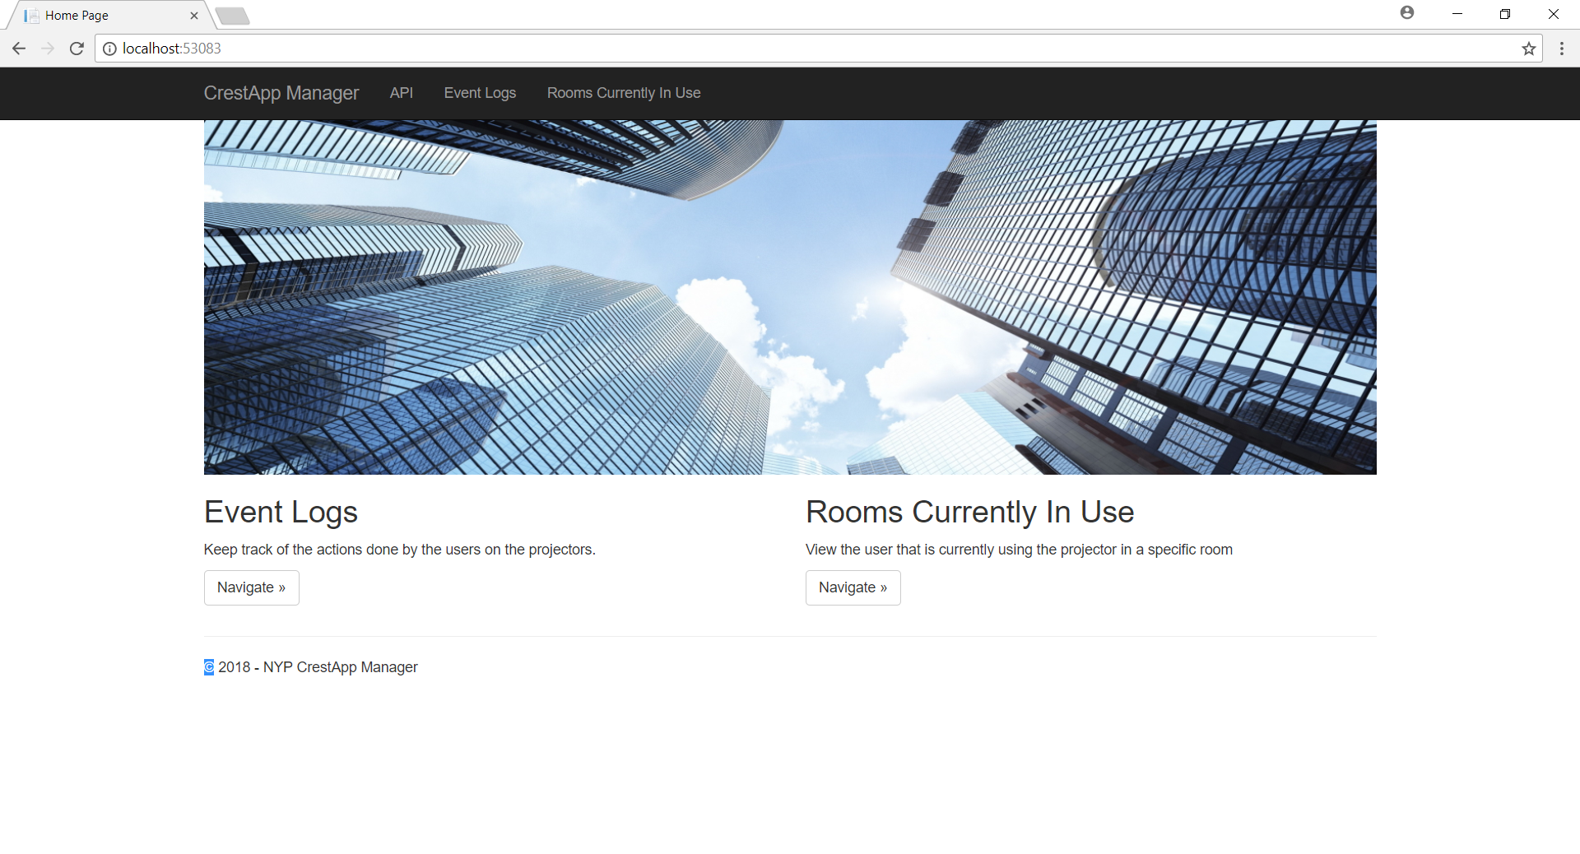
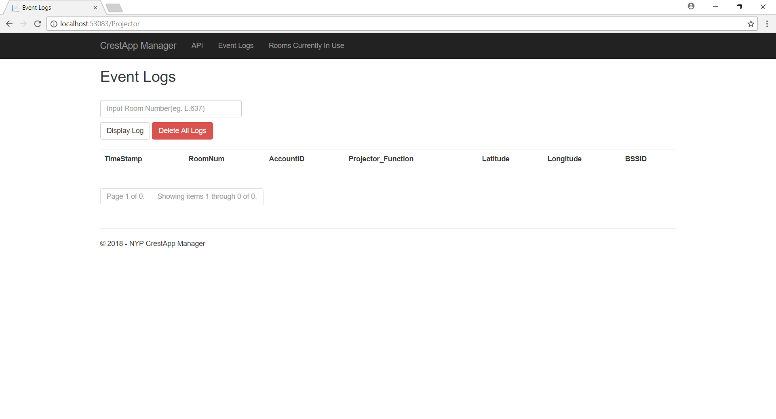
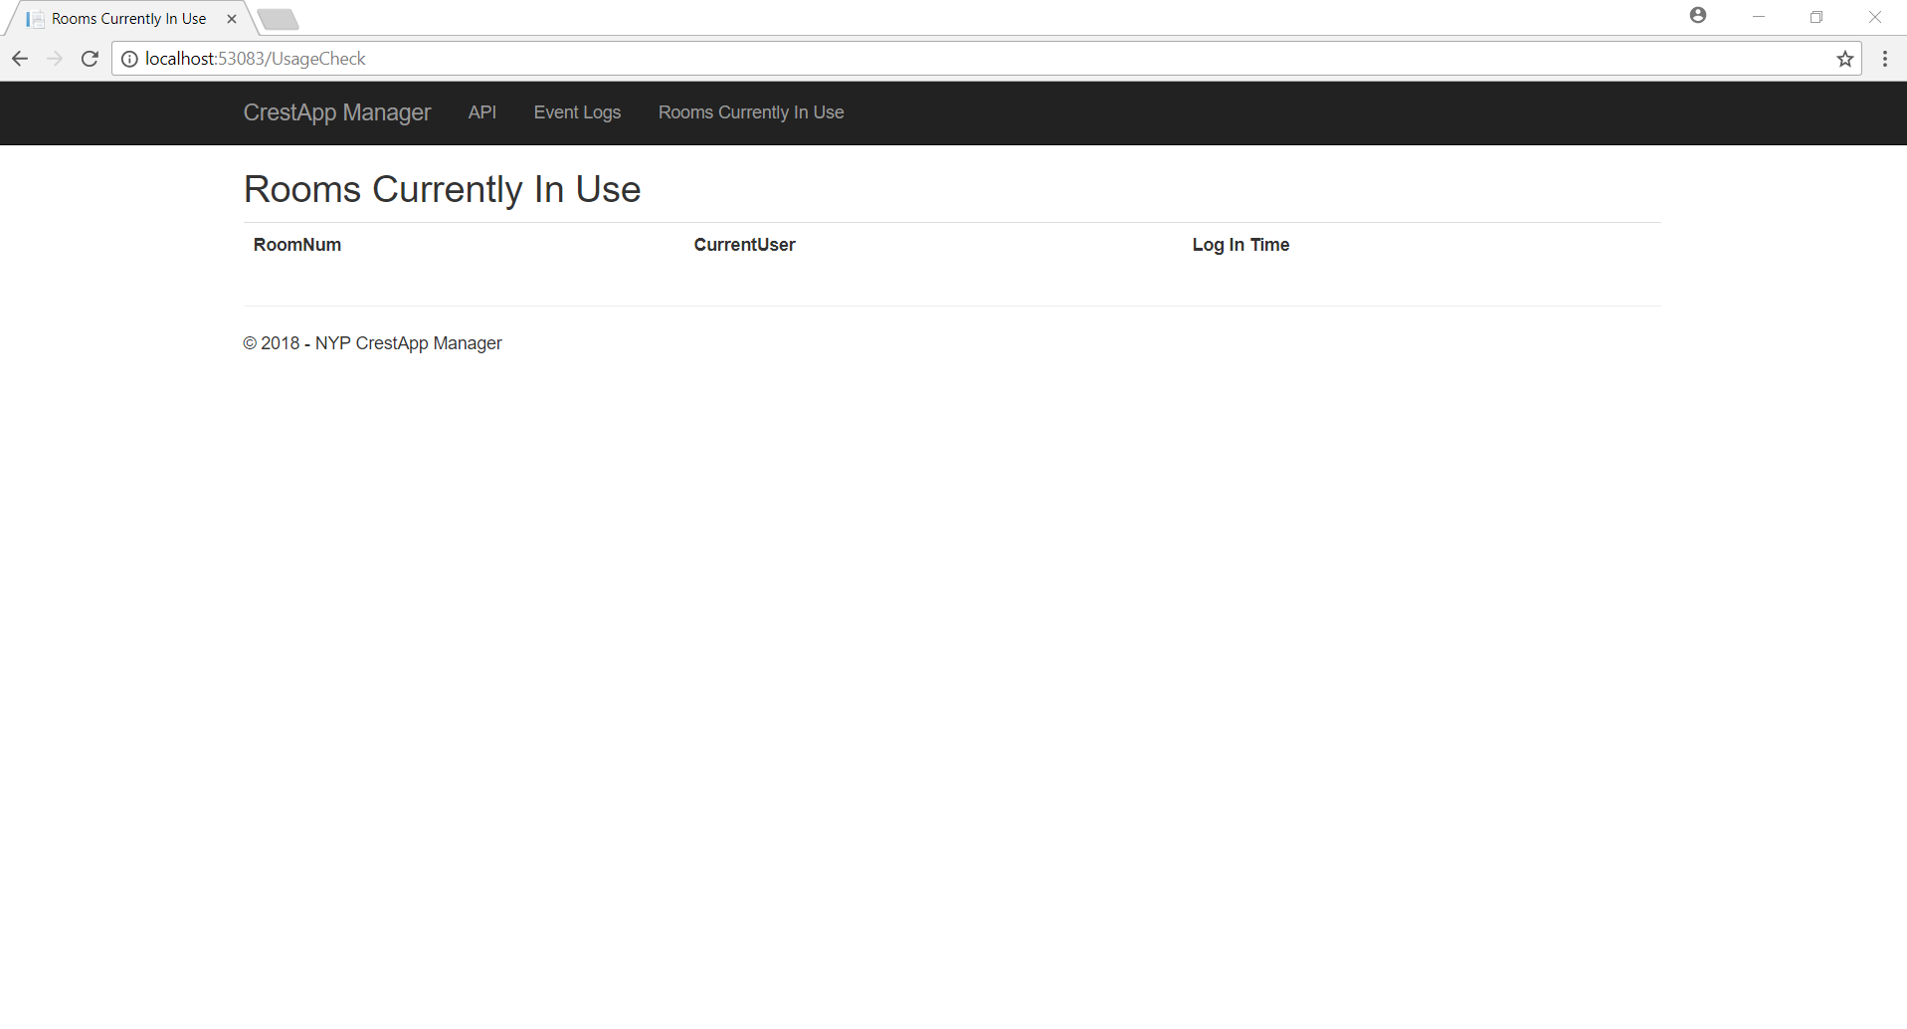
Previous Design
Main Page
Event Logs Page
Rooms in use page

Slide 15
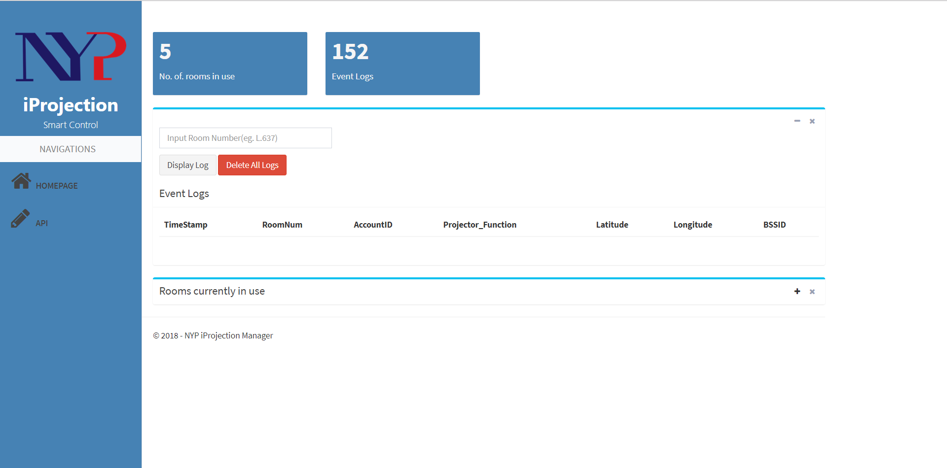
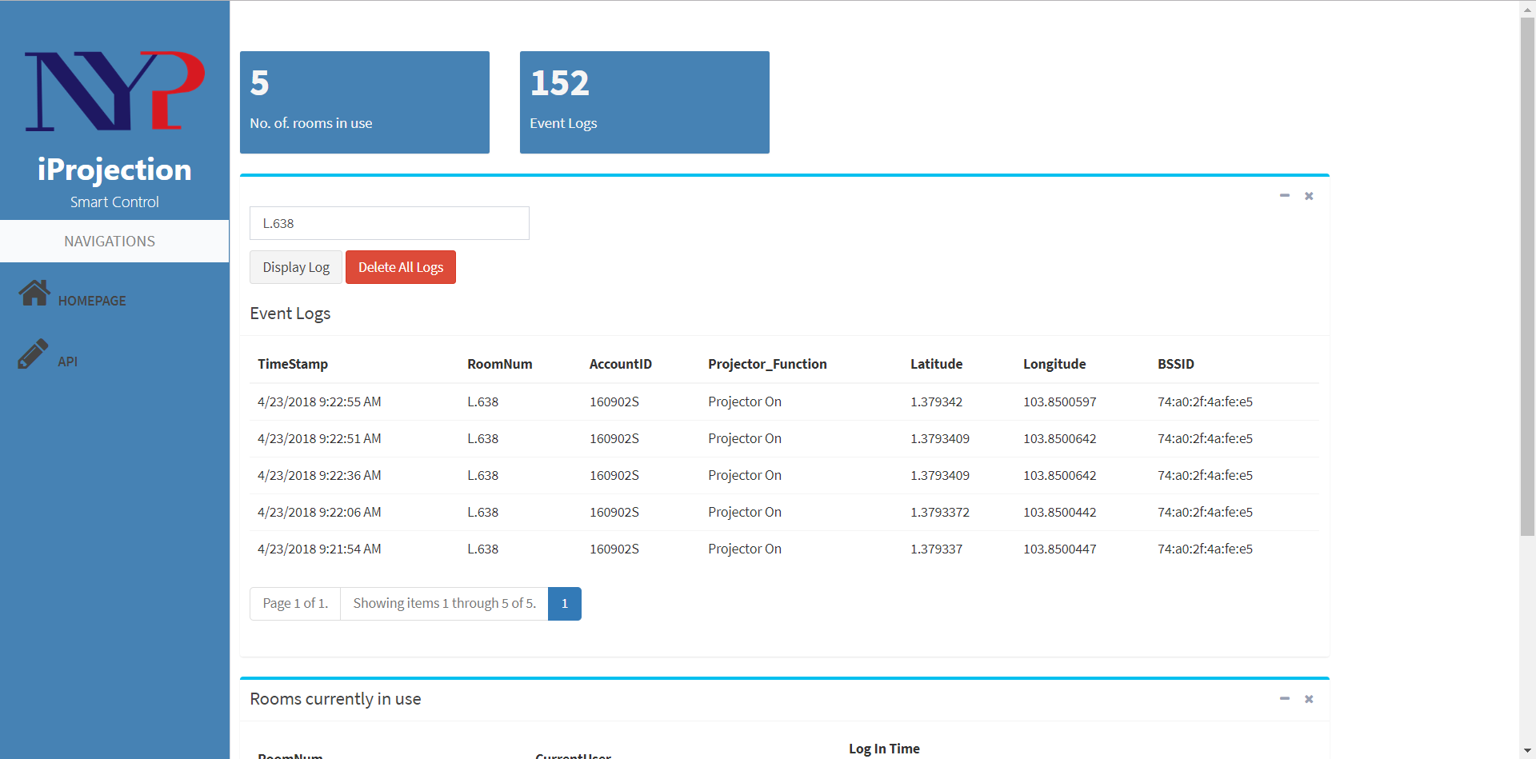
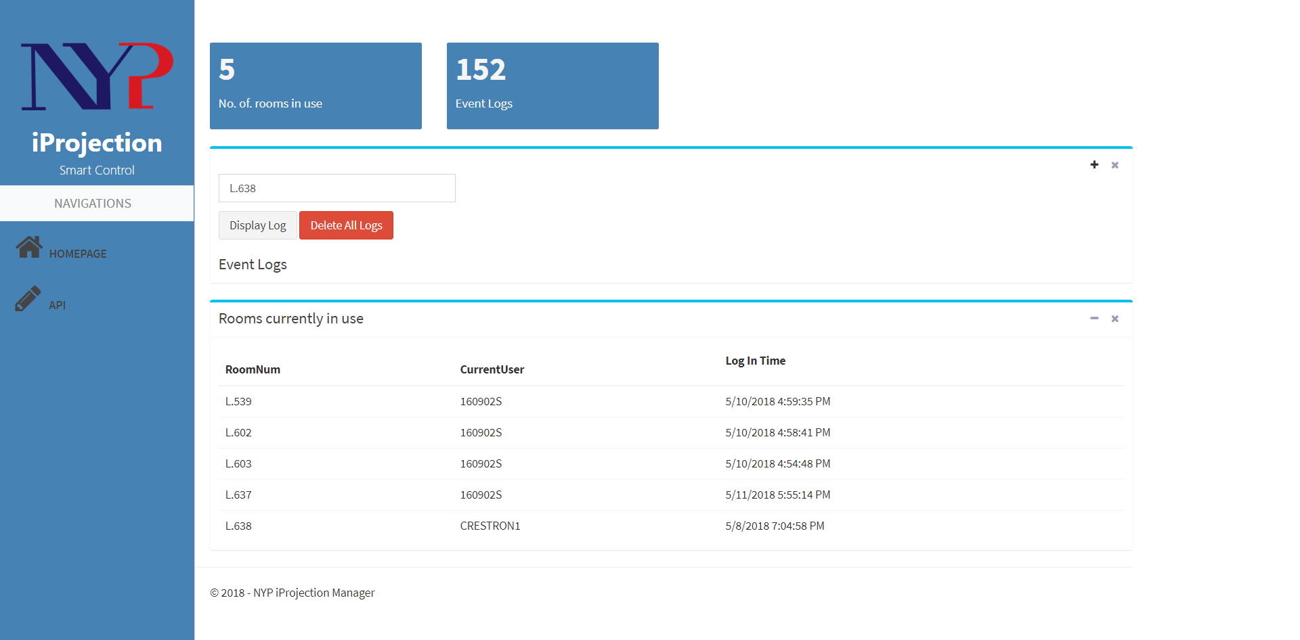
New Design
Main Page
Event Logs Page
Rooms in use page

Slide 16
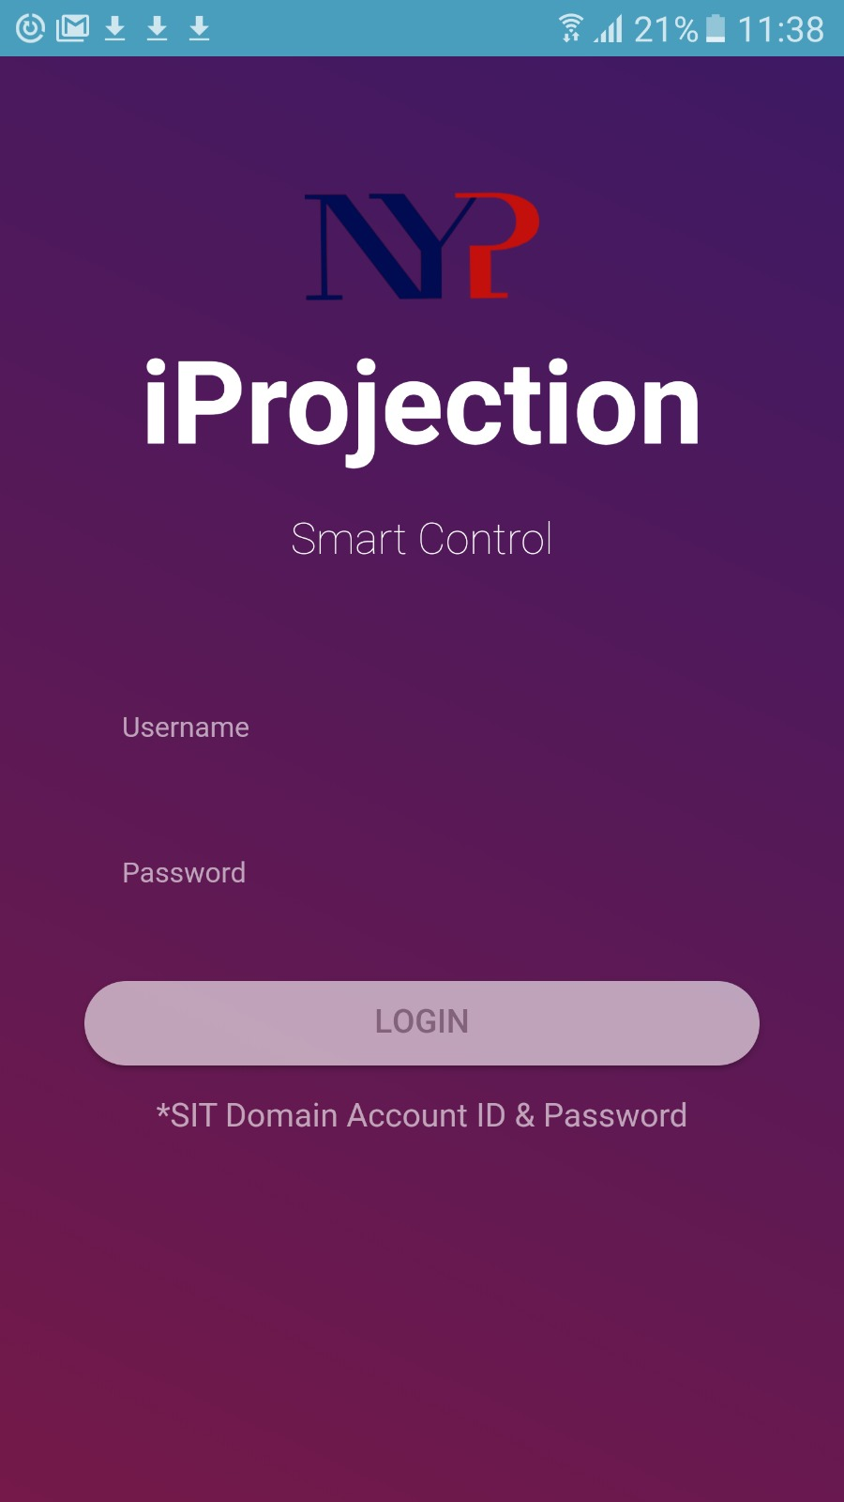
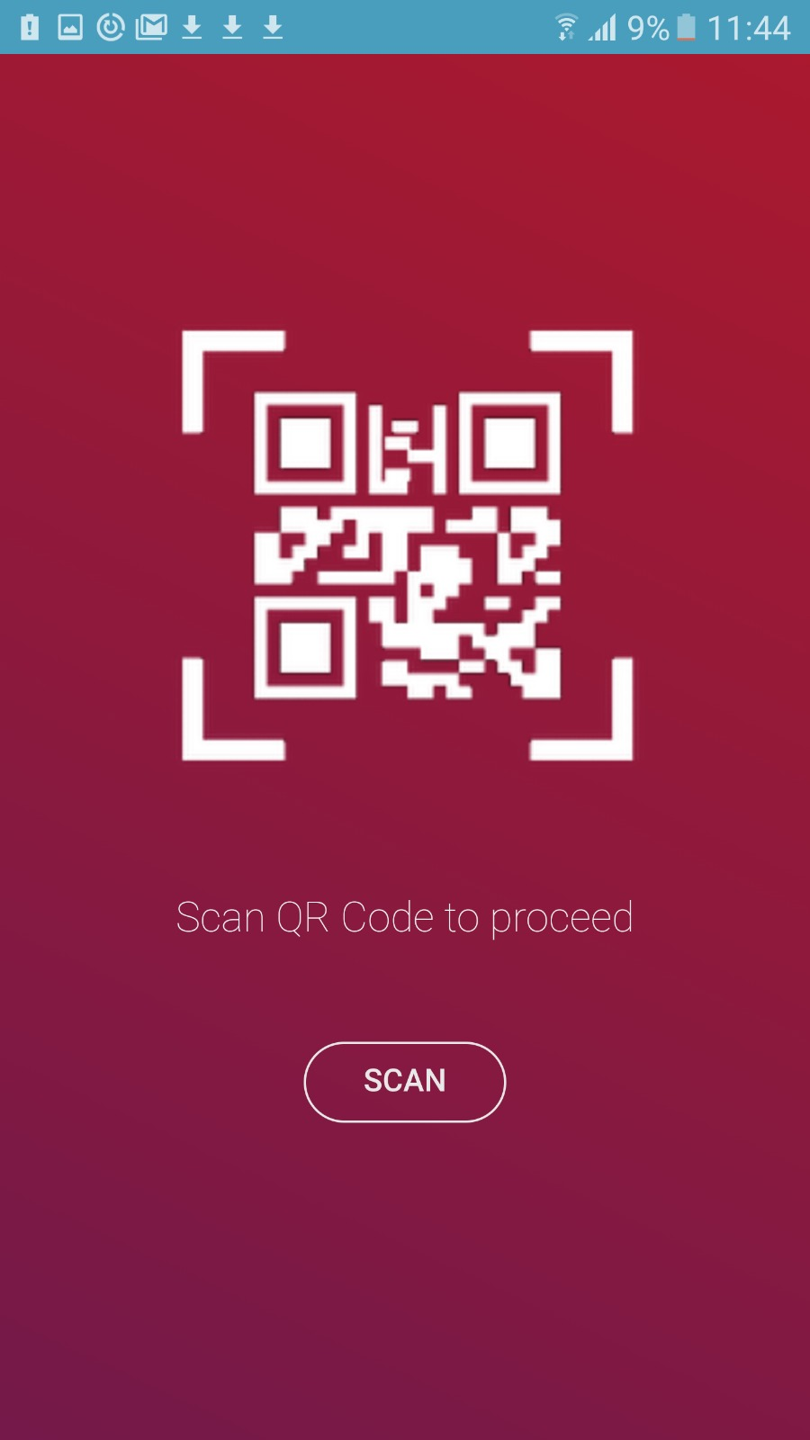
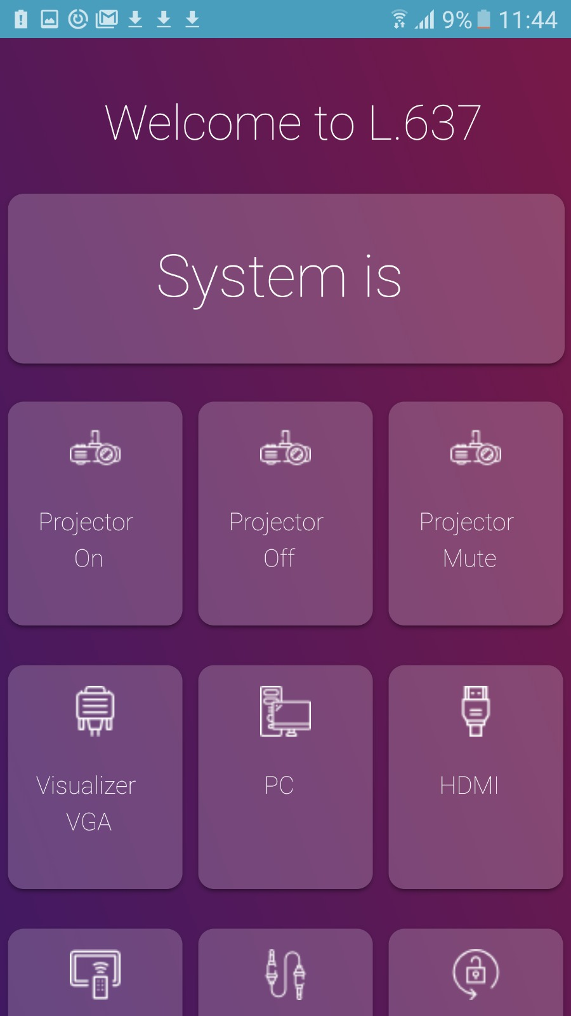
New Design
Login Page
Scan Page
Control Page

Slide 17
Mobile App Design
Login Page

Slide 18
Mobile App Design
Scan Page

Slide 19
Mobile App Design
Control Page

Slide 20
Web App Design
Home Page

Slide 21
Web App Design
Rooms in use Page

Slide 22
Web App Design
Event Logs Page

Slide 23

Q & A

